Slide 1



Introduction to Data Shift & Concept Drift
Mehdi Ataei – Vector Institute & University of Toronto
Ali Pesaranghader – CIBC Data Science & AI Research
March 26, 2021

Slide 2
Outline
Chapter I: Introduction
What is Data Shift?
Why Data Shift Happens?
Why Handle Data Shift?
What are the consequences of not properly addressing data shift?
How to approach data shift?
Chapter II: Data Shift
Data Shift Types and Patterns
Data Shift Detection & Correction
Transfer and Active Learning
Evaluation and Discussion
Packages
Chapter III: Discussion and Q&A

Slide 3
Introduction

Slide 4
Definition What is Data Shift?
In classic Machine learning, models are trained under the premise that the training and the real-world (i.e., both source and target) data are from the same distribution
Such assumption may potentially result in predictive problems in dynamic industries and environments where the distribution of data changes over time
The existence of such a difference between the dataset distributions is called as dataset shift in the machine learning community.
In fact, most real-world applications should cope with some form of shift as the distribution of the data used to train a model differs from the distribution of the data that the model encounters after its deployment.

Slide 5
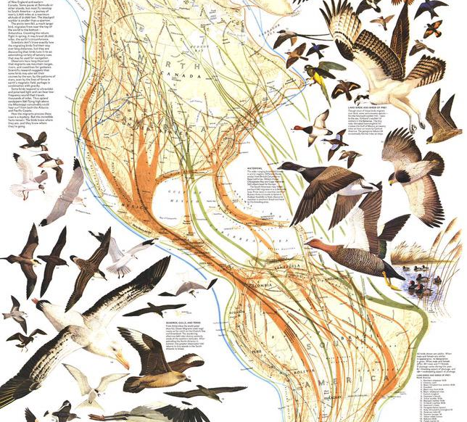


Why Data Shift Happens?
Reasons for experiences data shift could be:
Political
Industrial (Solar & Clean Energy)
Financial (Shift from Fiat to Crypto…!)
Retail (supply and demand)
Pandemic, e.g., COVID 19 and SARS
War & Immigration
House Price (2007)
IT & Internet (e.g., Dot-com)
Security & Privacy (Cyber attack)
Environmental (Global warming, weather)
Natural (Bird Migrations)
Dynamic nature (Smart Houses)
Unexpected

Slide 6

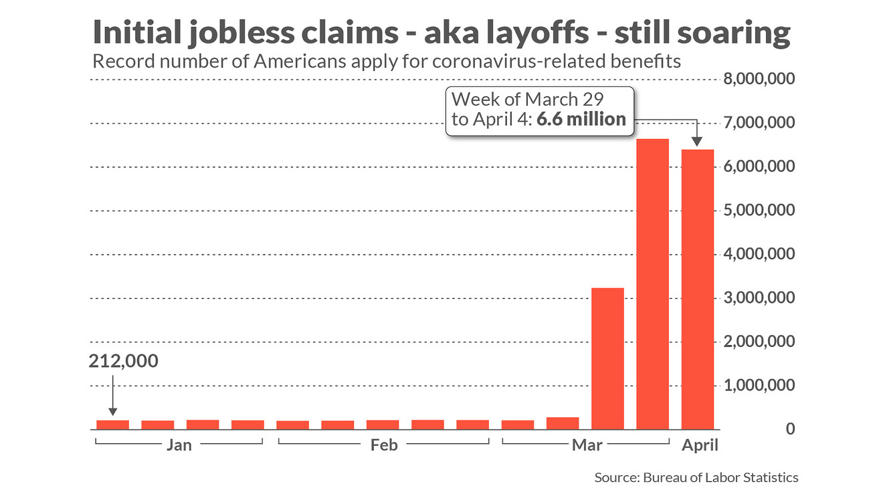
Motivation Why Handle Data Shift?
We train a model to predict “Jobless Claims” in the US
In practice, the model correctly predicts 200k claims for the fourth week of March 2020
COVID 19 hits and unemployment claims skyrocket
The model now predicts 800k claims; it’s higher than normal, but is it reliable? (In reality, it is over 6 millions…)
After pandemic, the model parameters (e.g., layoffs, closures, mobility, data, etc.) may have dramatically changed
The model trained on historical jobless claims data may underestimate the effect of the pandemic

Slide 7

Motivation Why Handle Data Shift?
Pre-COVID:
Trained a model to predict bankruptcy of an entity
Data:
70% Non-bankrupted,
20% Likely to Bankrupt,
10% Will Bankrupt
The model had an accuracy of 80% (vs. 33% for a random classifier)
Post-COVID:
After COVID, we observed:
40% Non-bankrupted,
60% bankrupted
Class distribution changed
The number of classes reduced
The model accuracy worsens although the problem is easier (a random classifier is now 50% accurate)

Slide 8

Motivation – Cont. Why Handle Data Shift?
Consequences of not handling data shift could be loss of:
Lives
Clients
Resources
Funds
Time
Trust
Reputation

Slide 9
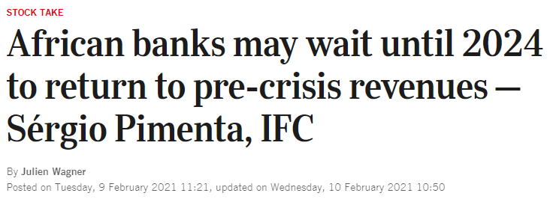
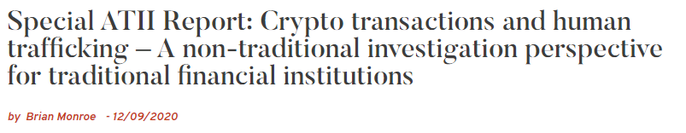
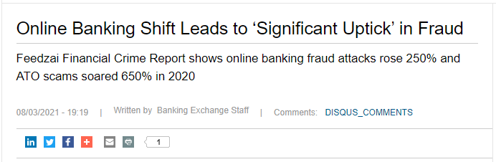
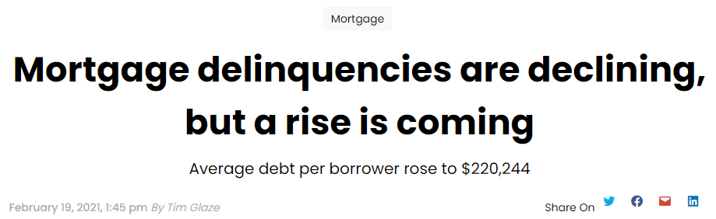
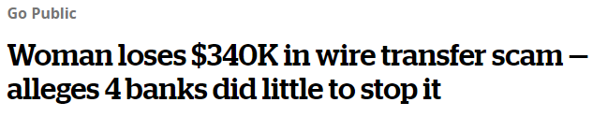
Motivation – Cont. Why Handle Data Shift?
Consequences of not handling data shift in the finance world:
Financial crimes:
Terrorist financing
Money laundering
Fraudulent transactions
Scamming
Slavery and human trafficking
Client focused:
Inadequate financial plans
Poor product recommendation
Mortgage delinquency
Credit and loan defaults
Attrition & losing clients
etc.

Slide 10
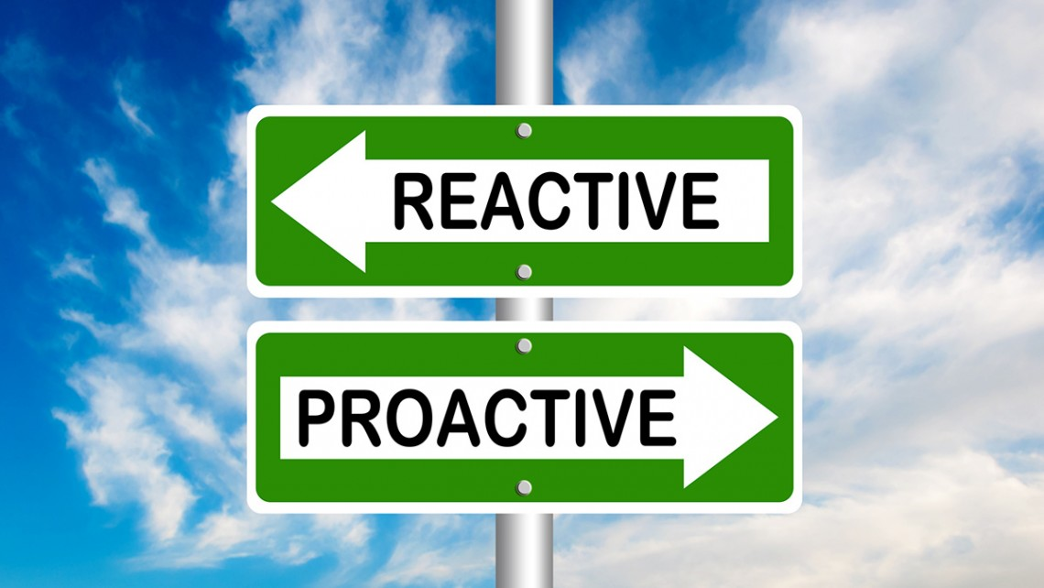
How to approach data shift?
Reactive
Proactive
React once something happened
Transfer learning (reusing old models)
Adaptive learning (efficiently retraining)
Statistical correction
It is easier but more risky
React before something happens
Adding mitigation steps in ML pipelines
Using historical data to retrain the model (using COVID data for future pandemics)
Using synthetic datasets to estimate data shift e.g., adversarial training
It’s not perfect. Must be an oracle.
It is harder but less risky

Slide 11
Data Shift

Slide 12
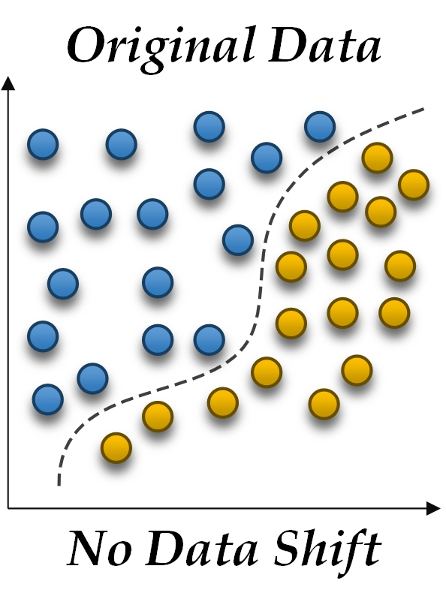
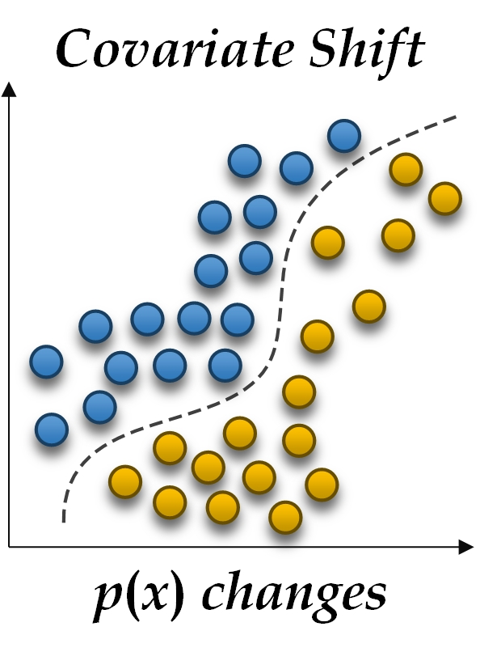
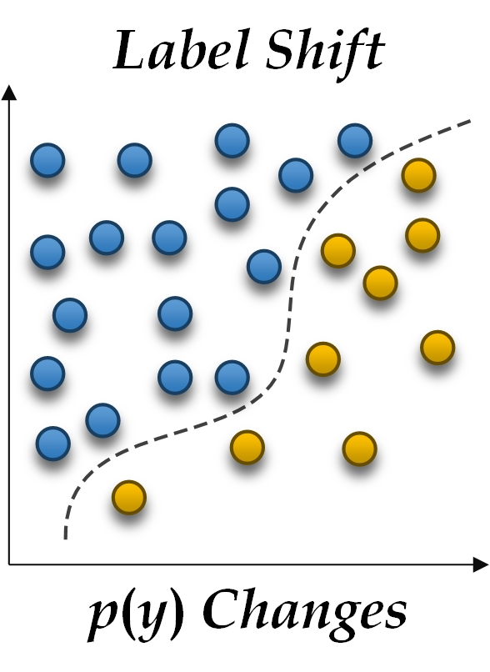
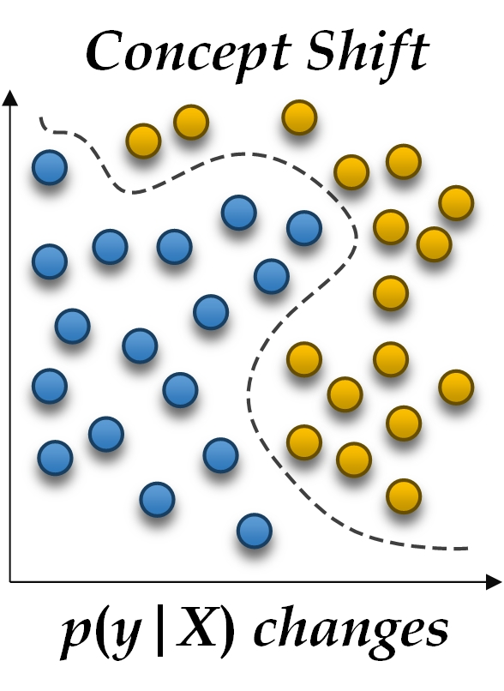
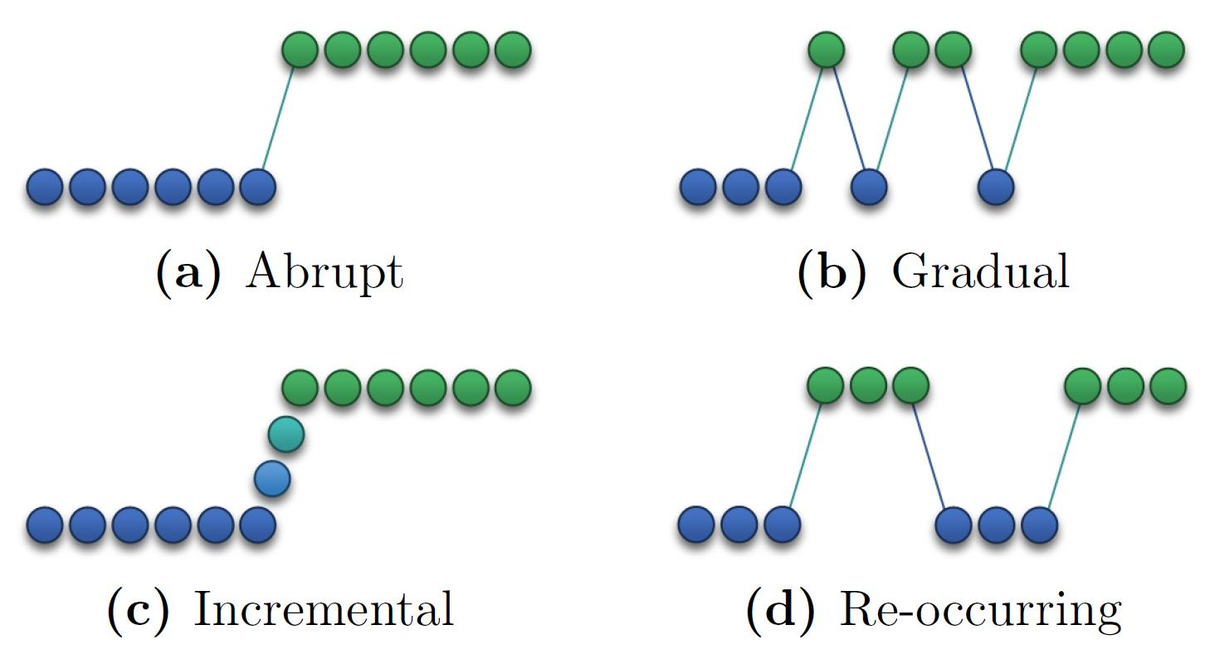
Data Shift
Common types of data shift:
Covariate shift
Label shift
Concept shift
Data shift patterns:
Abrupt
Gradual
Incremental
Re-occurring (or recurring)

Slide 13
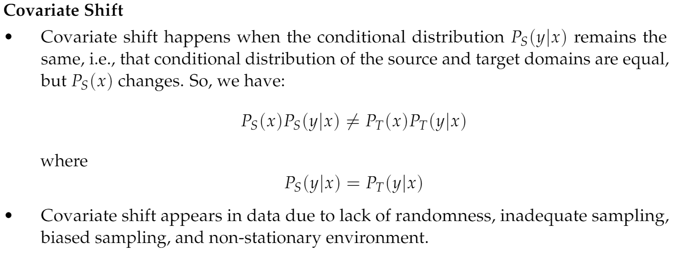
Data Shift Covariate Shift

Slide 14
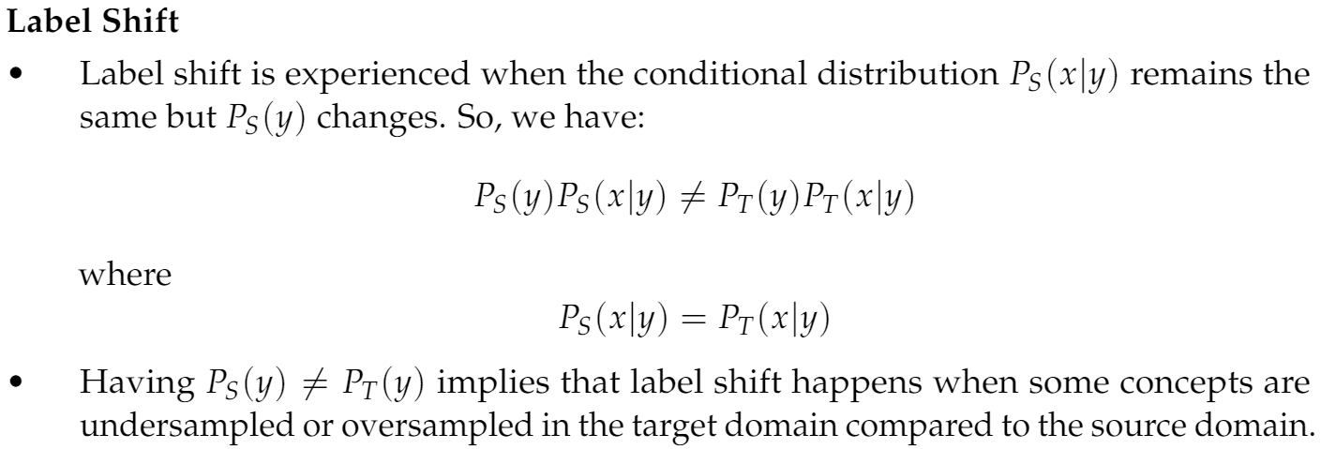
Data Shift Label Shift

Slide 15
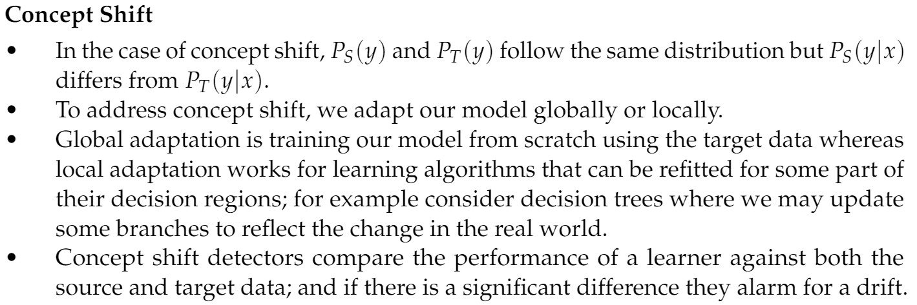
Data Shift Concept Shift

Slide 16
Data Shift Detection

Slide 17
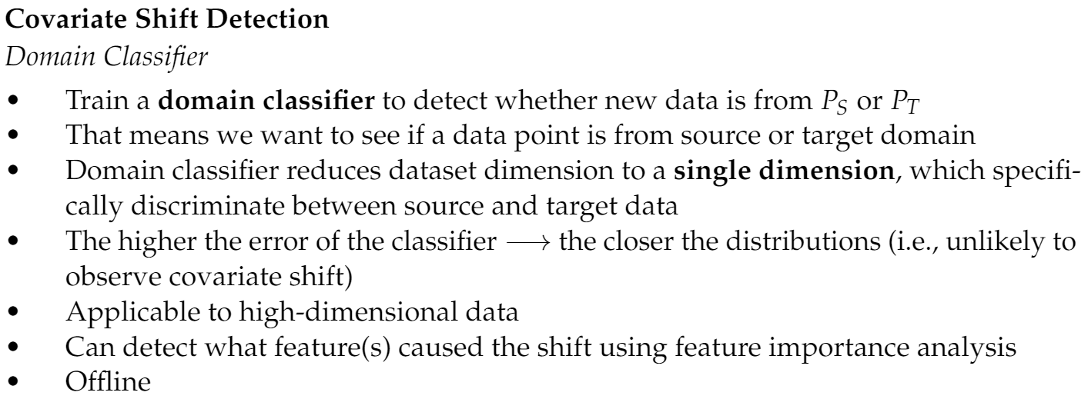
Covariate Shift Domain Classifier

Slide 18
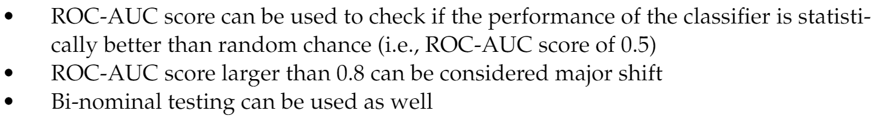
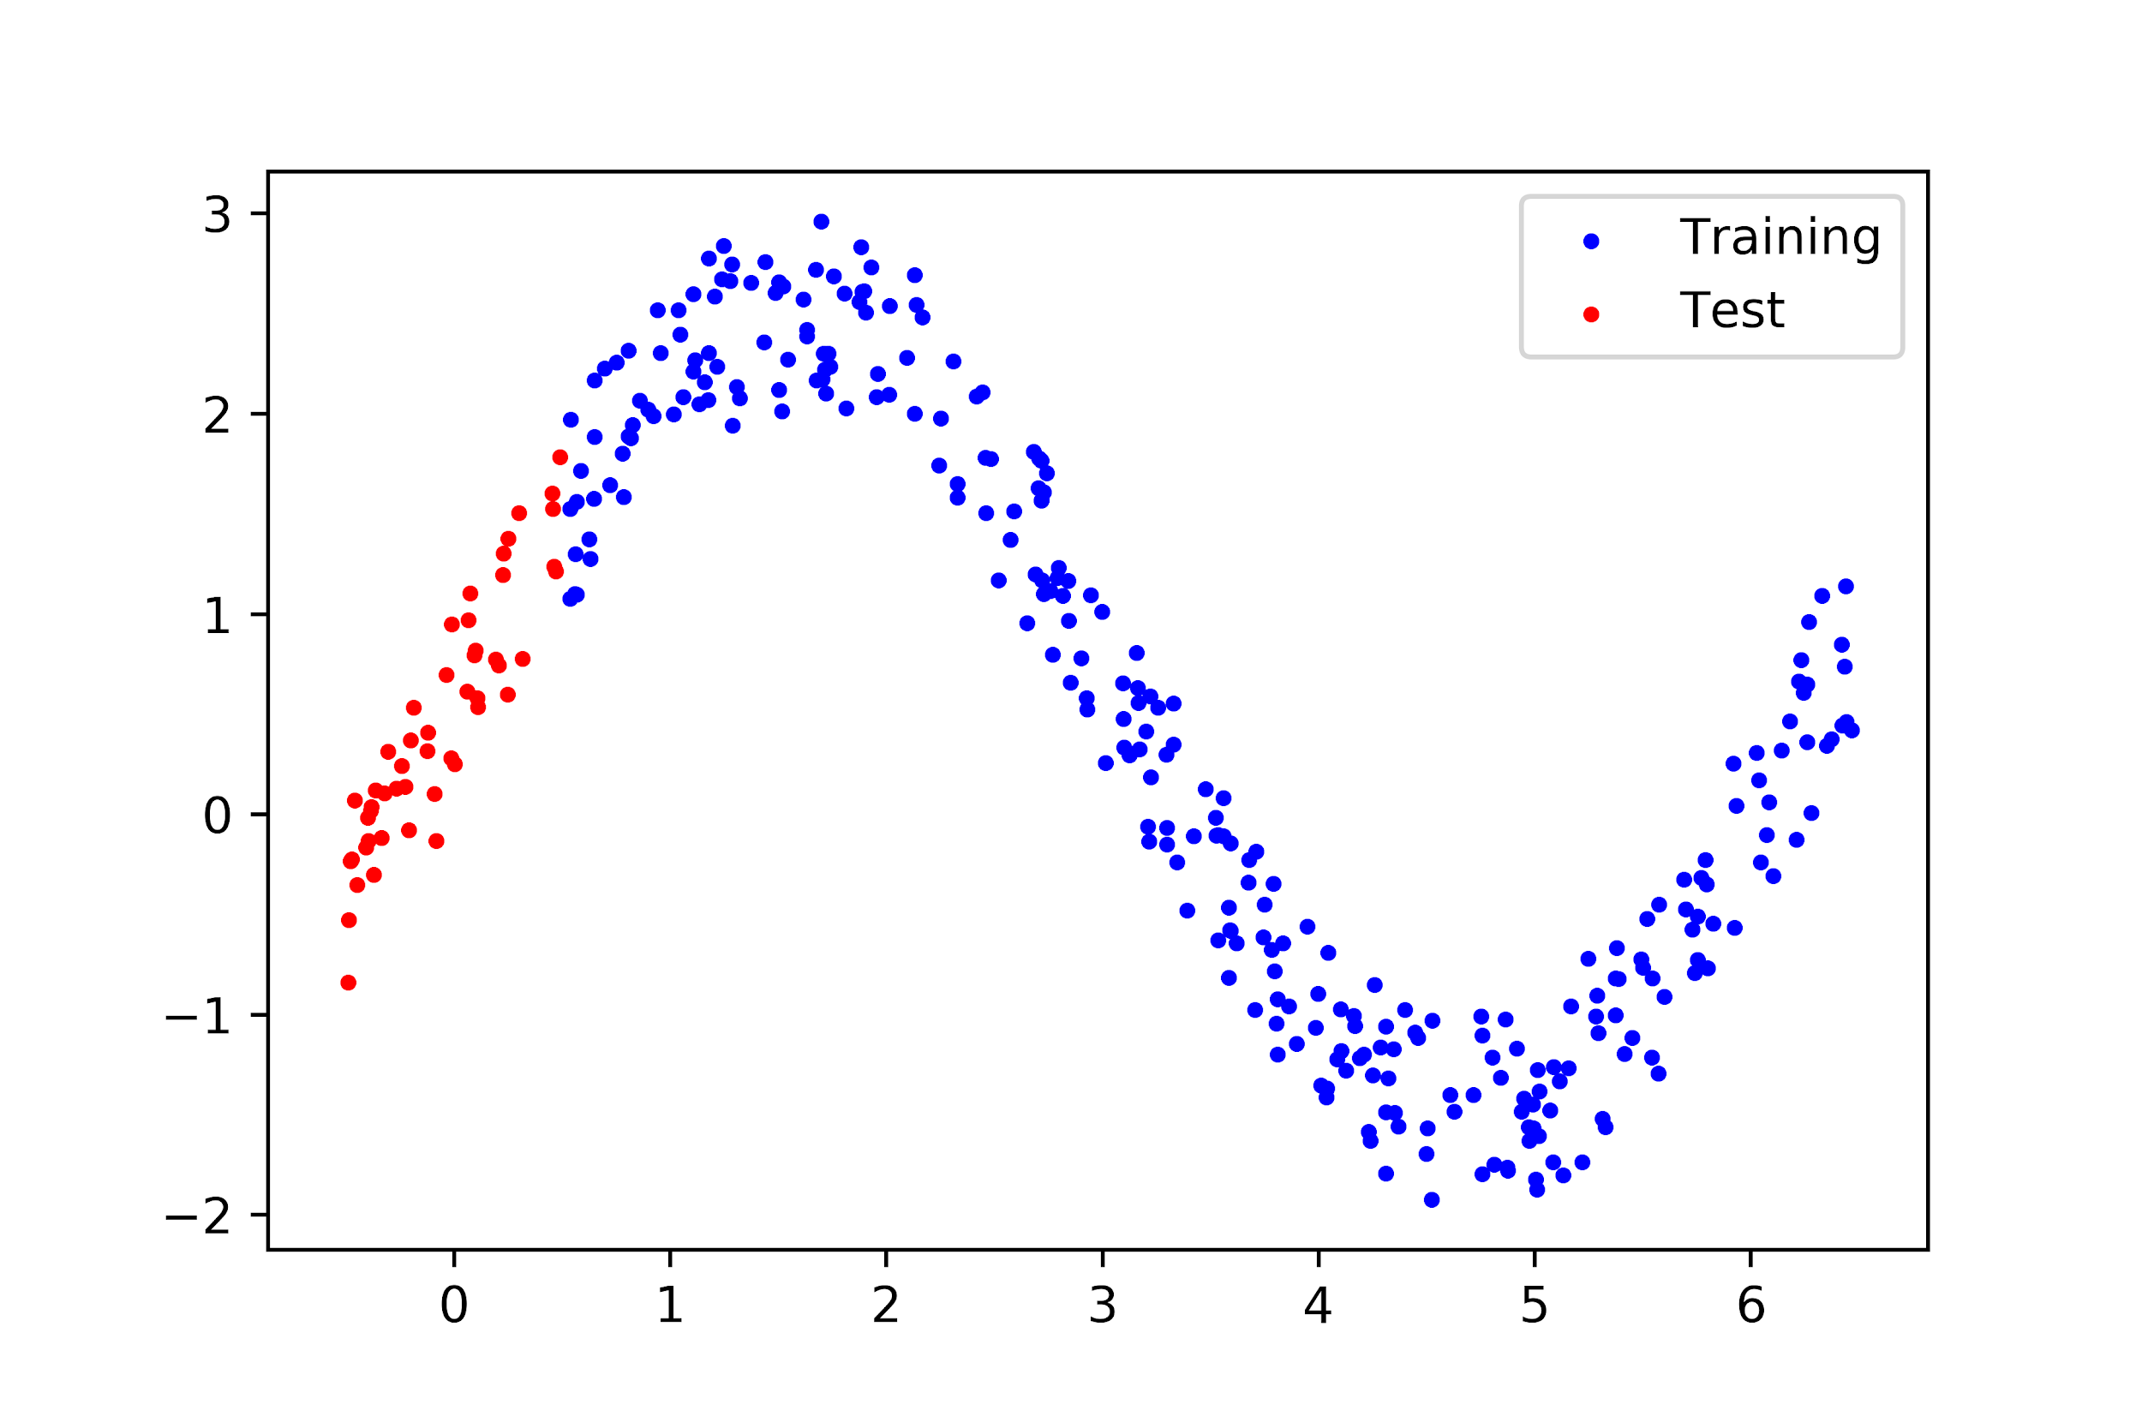
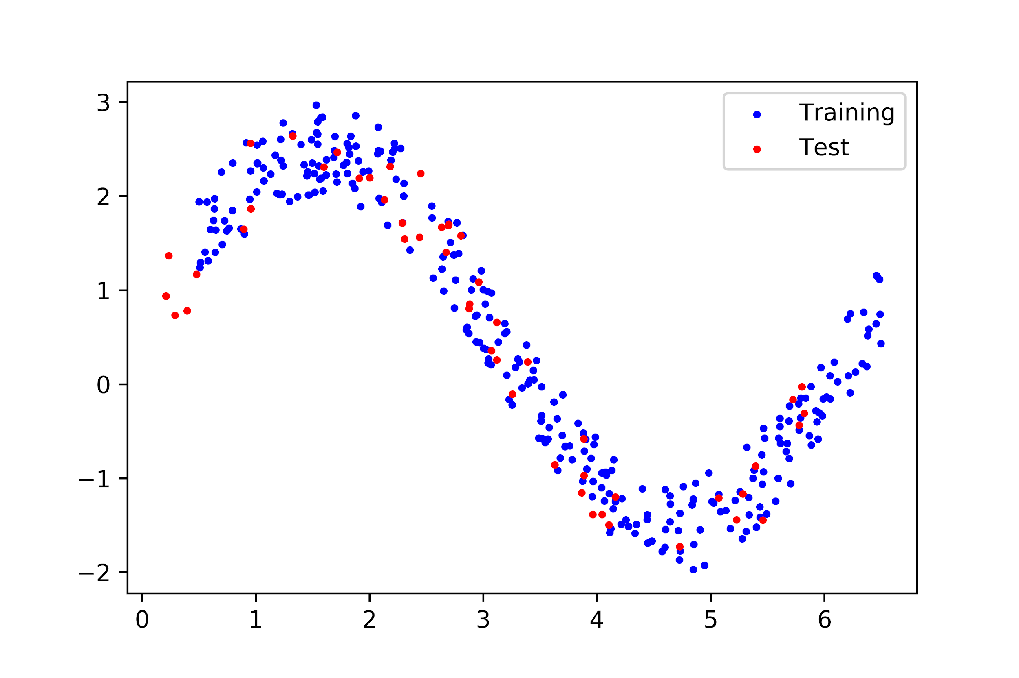
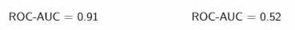
Covariate Shift – Cont. Domain Classifier

Slide 19
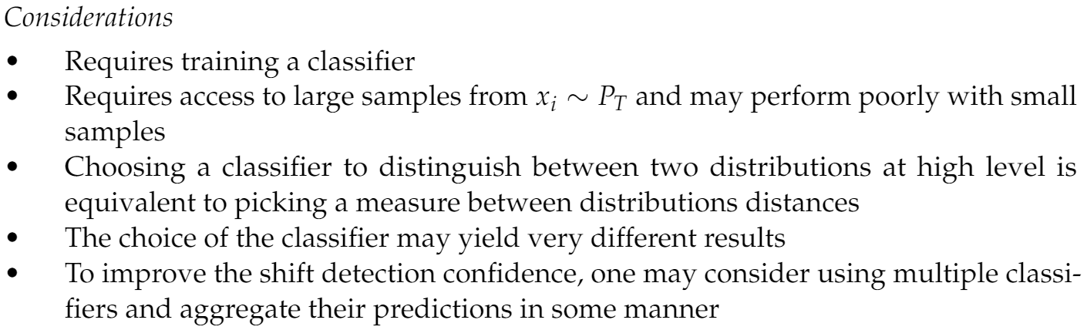
Covariate Shift & Domain Classifier – Cont.
Important considerations

Slide 20
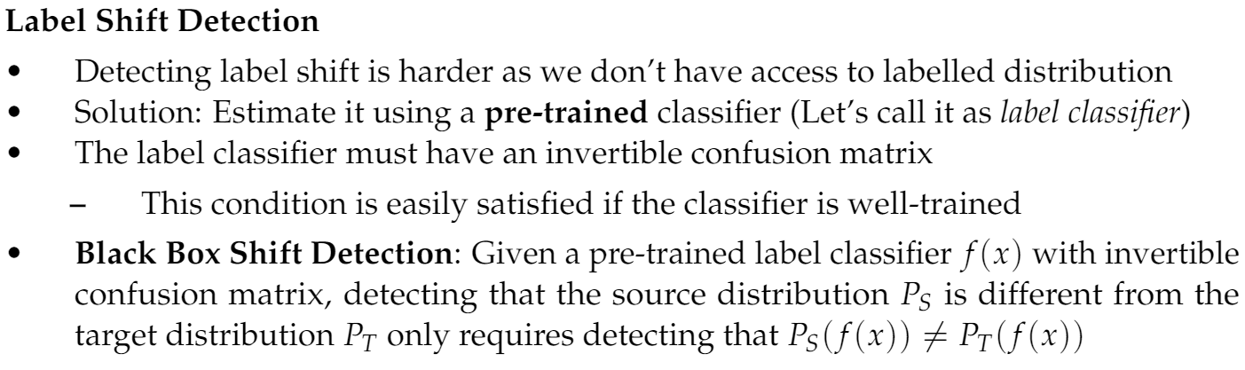
Label Shift Black Box Shift Detection

Slide 21
Data shift Correction

Slide 22
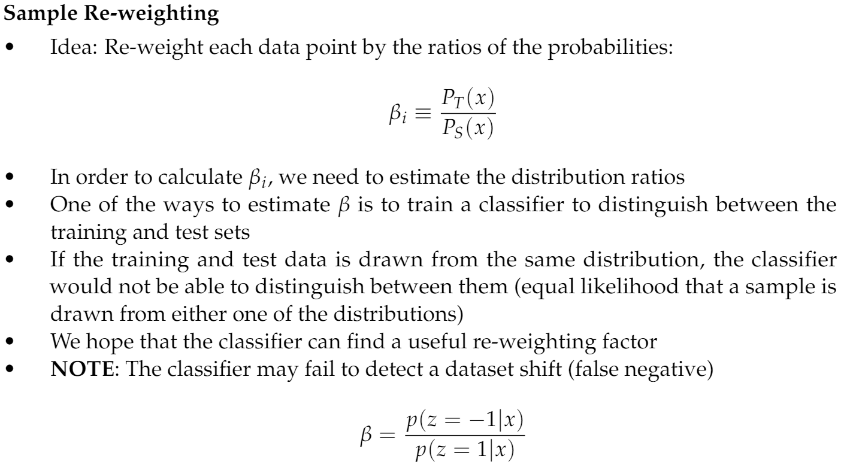
Sample Re-weighting

Slide 23
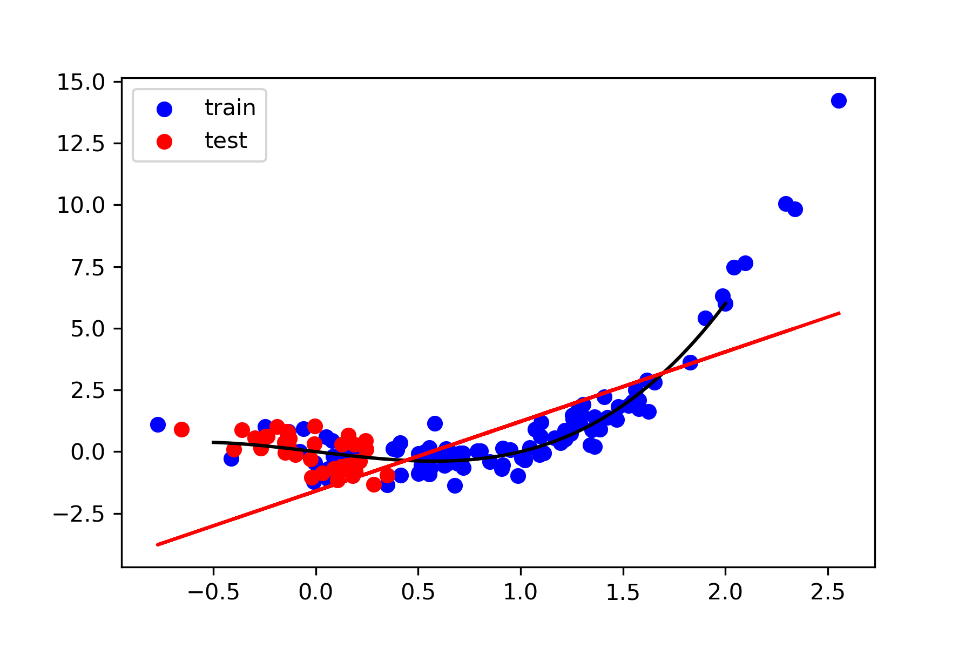
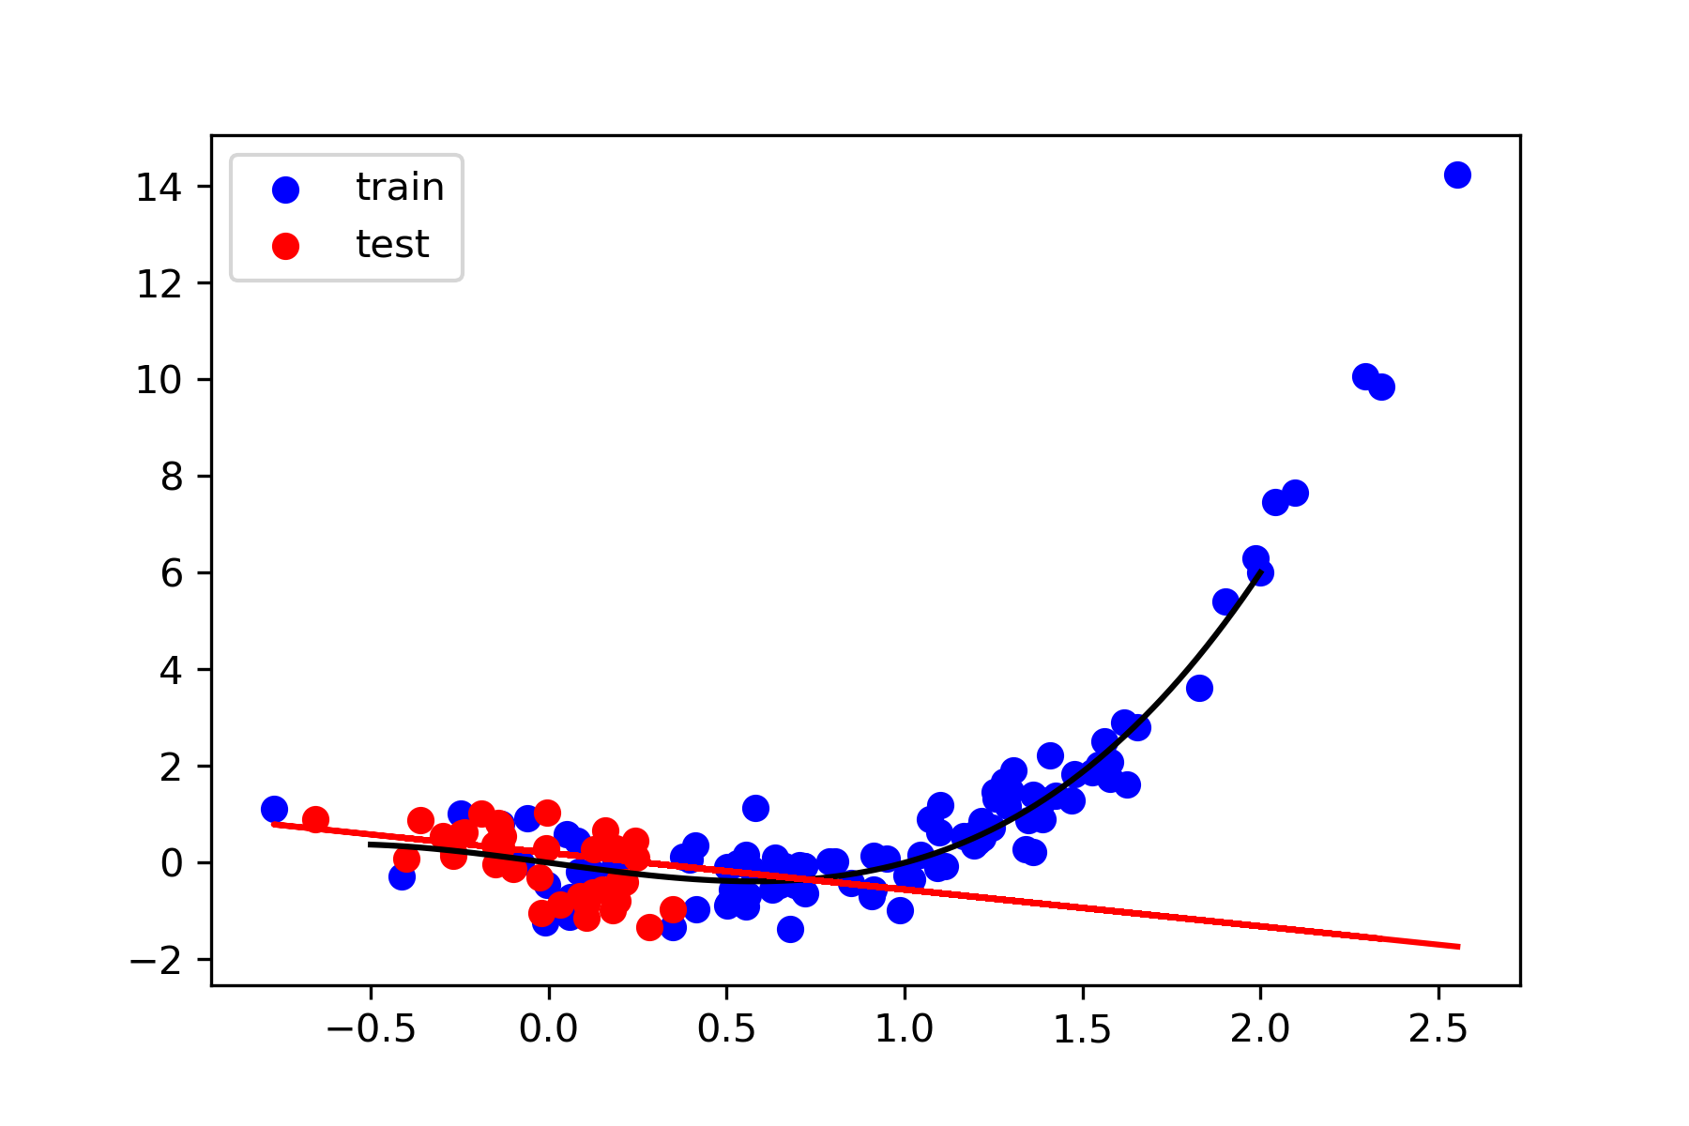
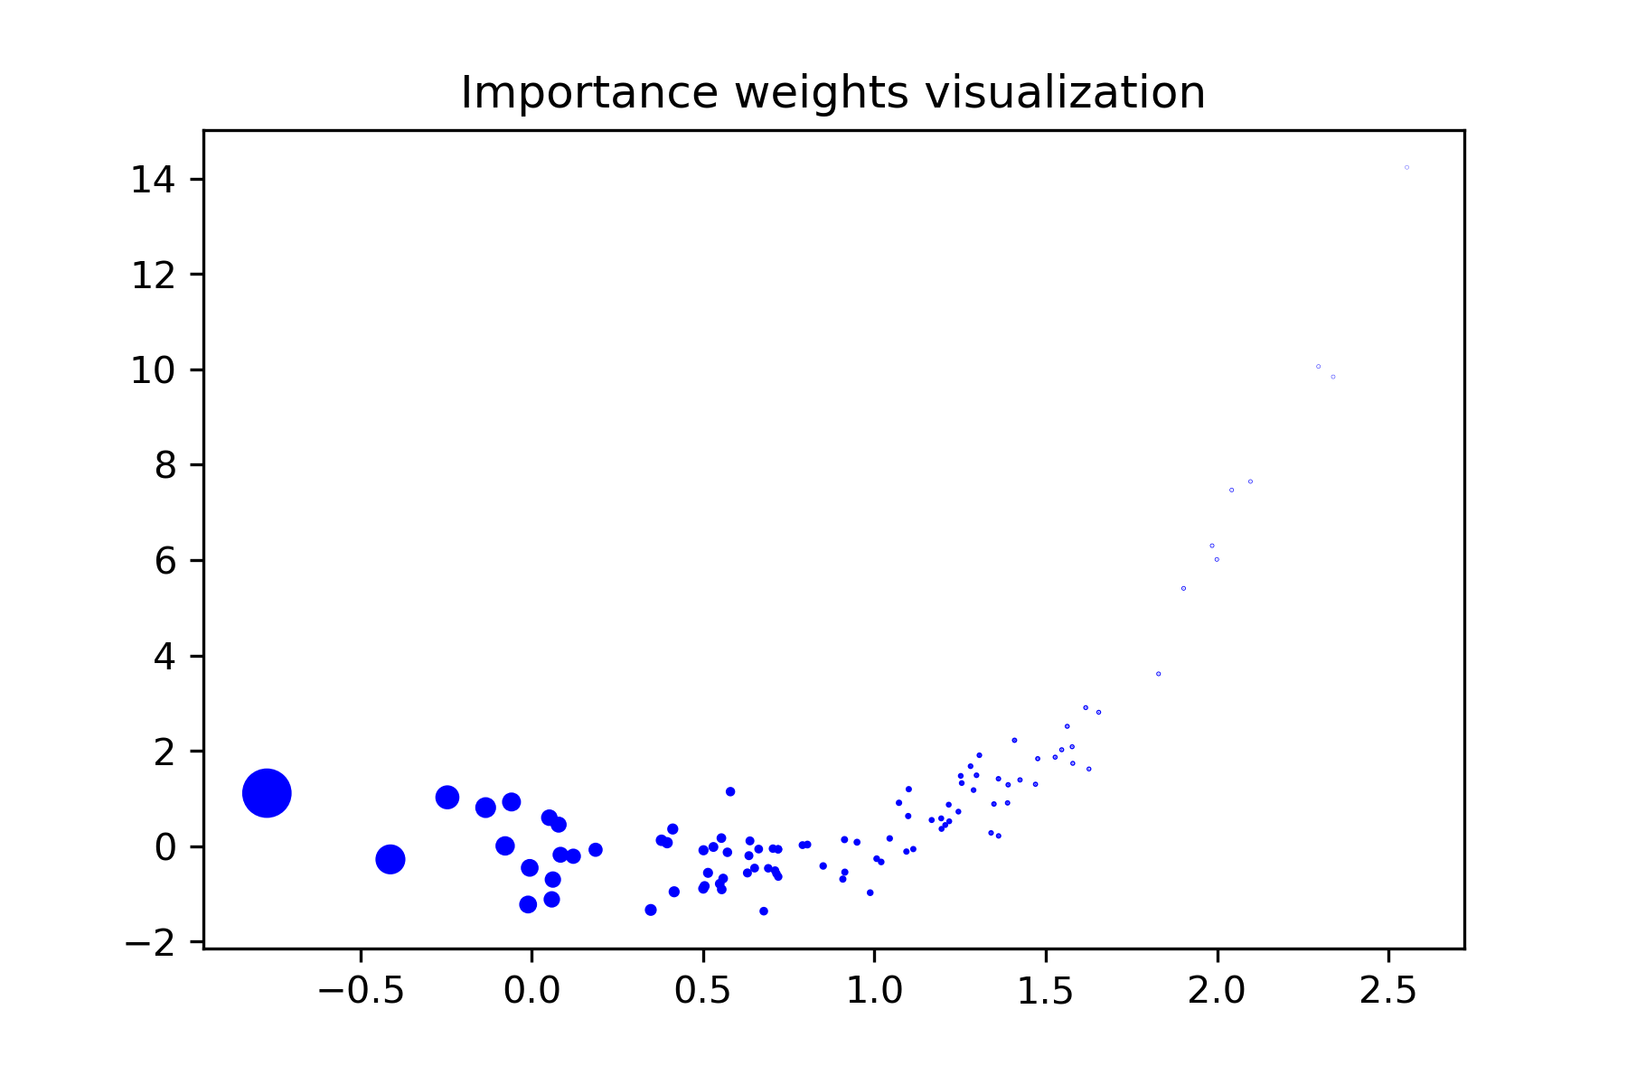
Sample Re-weighting Example
Re-weighting

Slide 24
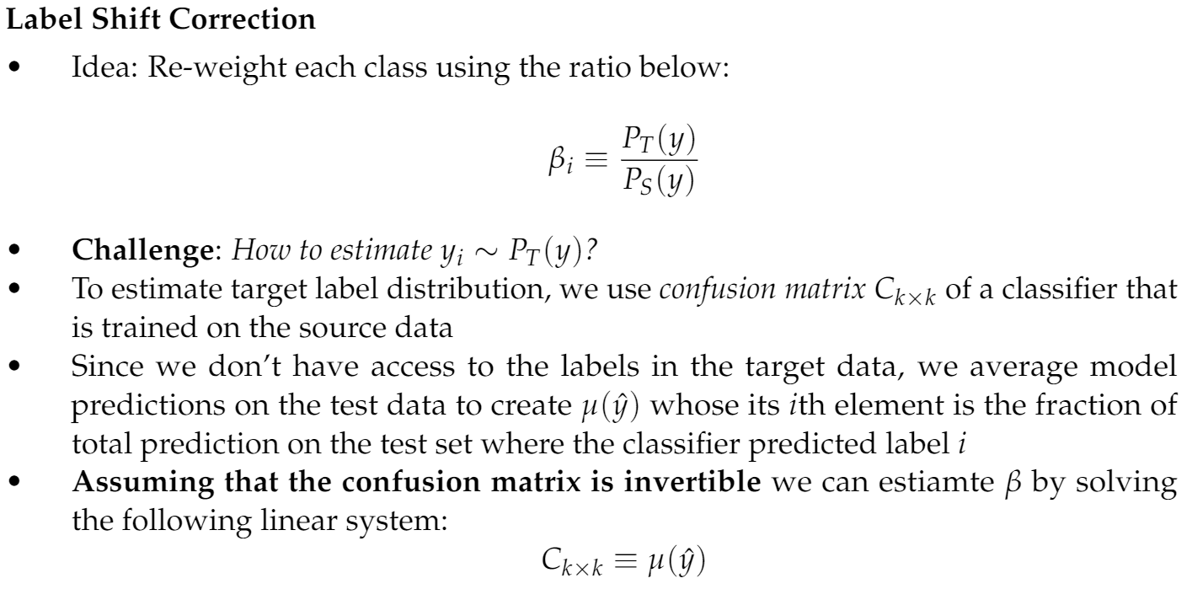
Label Shift Correction

Slide 25
Concept Shift Correction

Slide 26
Advanced Transfer Learning &
Active Learning

Slide 27
What if we could not correct a model?
Transfer learning - Reusing an existing model
Same domain, different tasks
Target data has more/less classes (CIFAR-10 vs CIFAR-100)
Completely different tasks (trained for question-answering, used in sentiment analysis)
Different domains, same task
Training on grayscale images and testing on colored images
Active learning - Learning interactively with fewer training labels
Not enough data from the target domain
Significant difference between the source and target distributions (no overlap)
We have the option to collect new samples: how can we do it more efficiently and effectively?

Slide 28
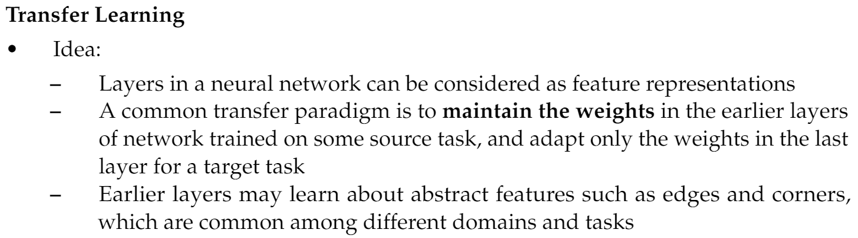
Transfer Learning

Slide 29
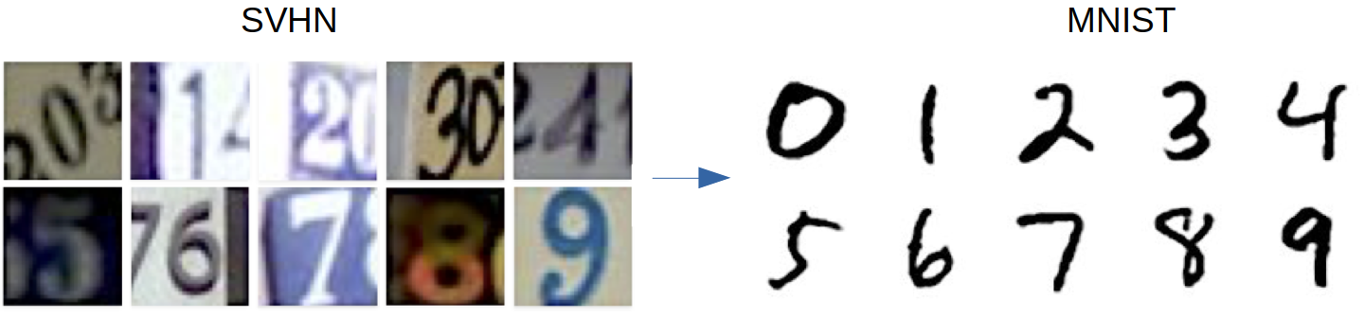
Transfer Learning – Cont.
Different domains, same task

Slide 30
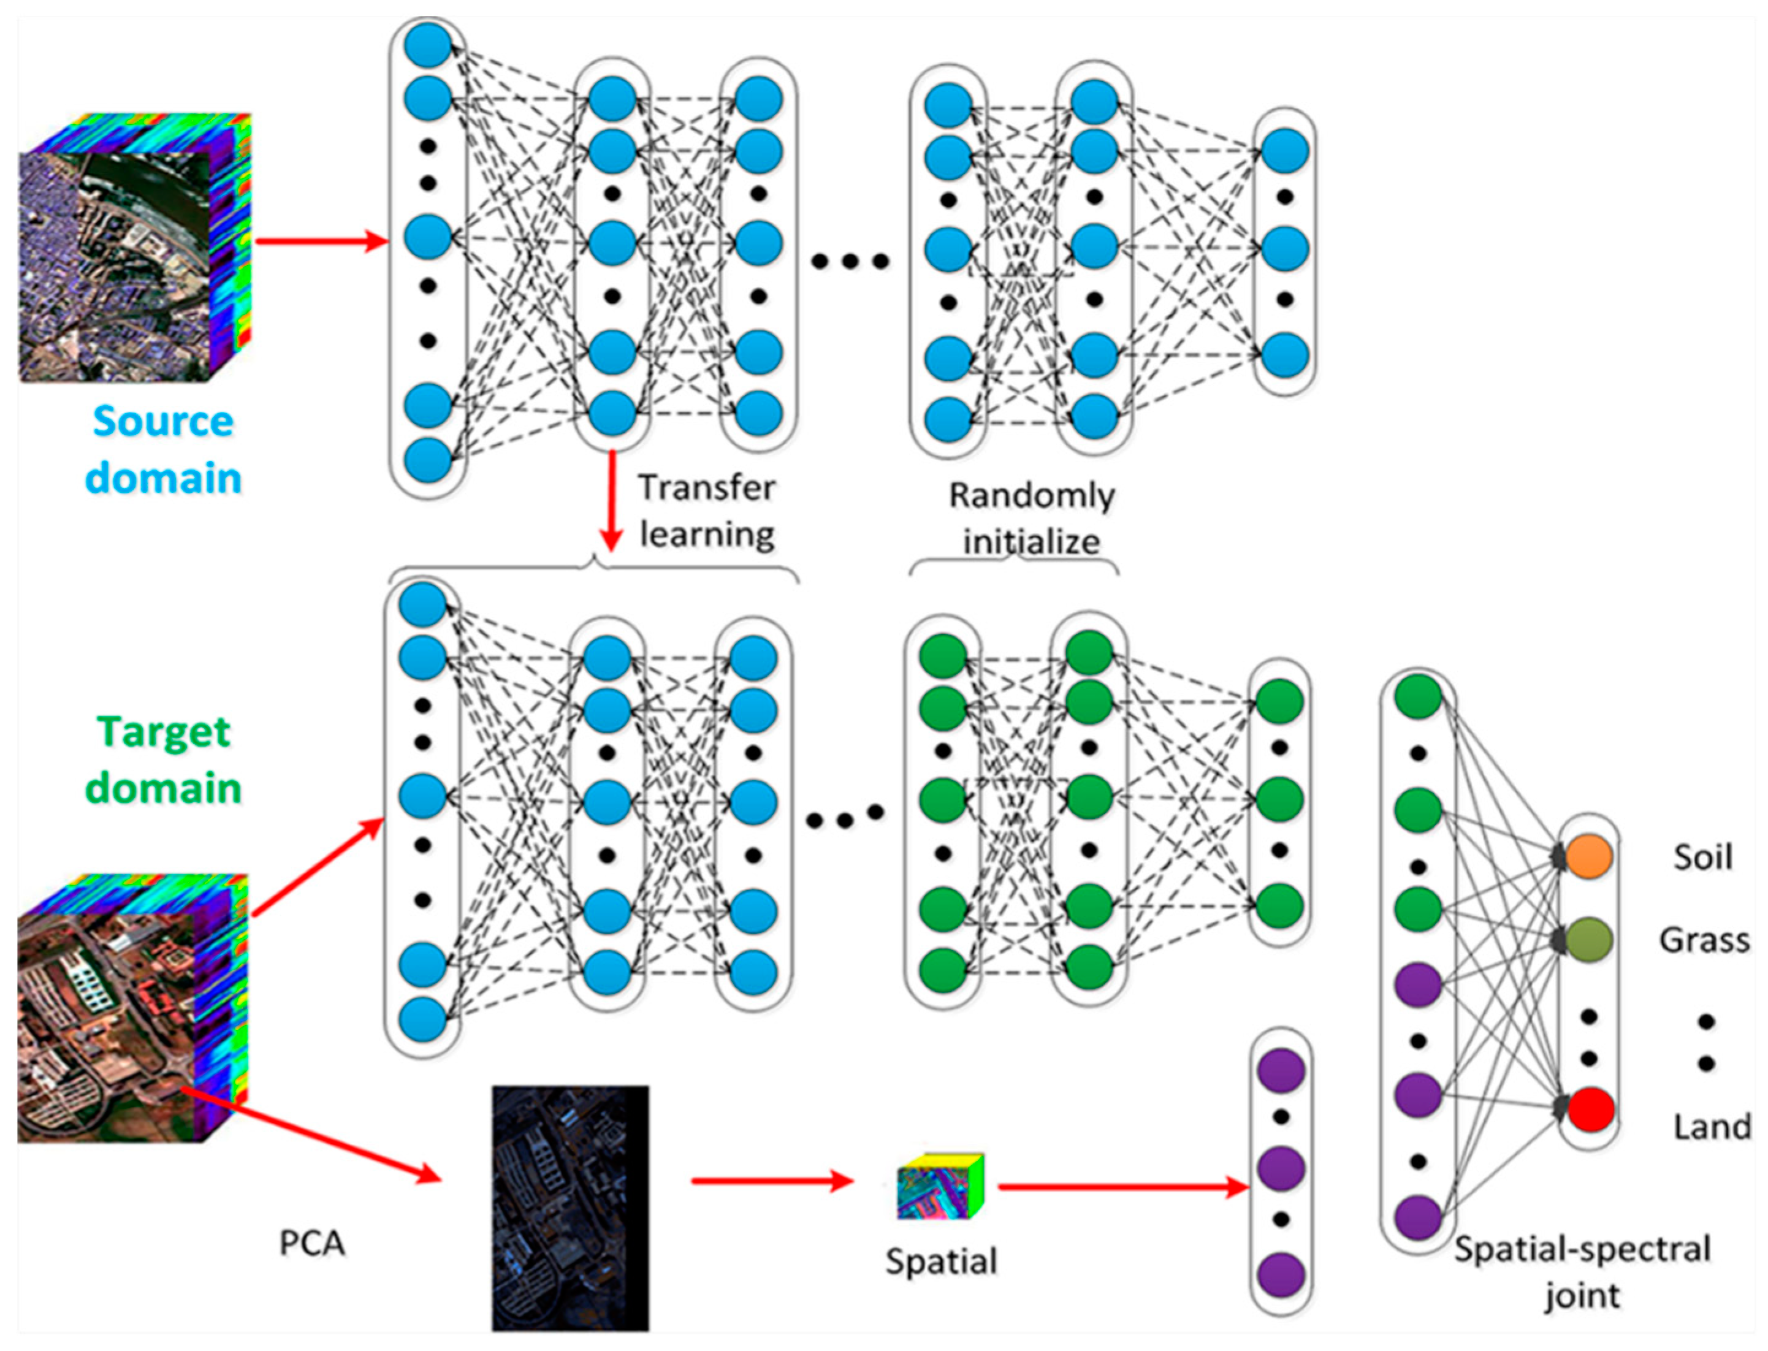
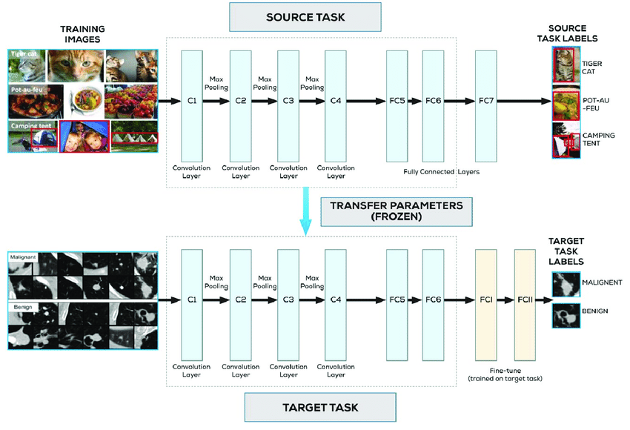
Transfer Learning – Cont.
https://www.mdpi.com/2076-3417/9/7/1379/htm
https://pubmed.ncbi.nlm.nih.gov/30383900/
Same domain (colored images), different tasks

Slide 31
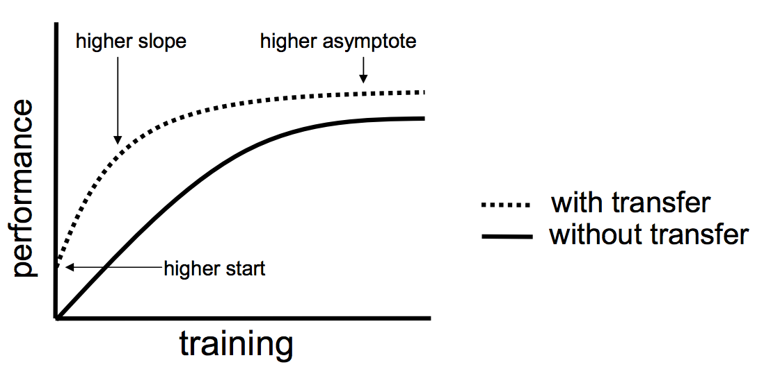
Transfer Learning – Cont. Benefits
Use the knowledge gained by a machine learning model from one task and apply it to a different task
Possibility of reusing the same model
The model training may have a higher start
The training rate would improve
The overall model performance may increase

Slide 32
Active Learning
The model prioritize the labeling of new data such that training the model on the new data would have the maximum impact on model performance
Interactively query the user to label new data points
Can significantly reduce the number of new labeled data points required
Query selection strategies
Uncertainty Sampling
Classification uncertainty: Being less confident about the model predictions - probabilities are not significantly different
Classification entropy: Uncertainty is proportional to the average number of guesses one must make to find the correct class

Slide 33
Active Learning – Cont. Types
Pool-based active learning
The model has access to a large pool of unlabeled data points
Query or rank the most informative samples
Stream-based active learning
Stream of unlabeled samples
Decide to query the user for labeling of the streamed sample or not

Slide 34
Discussion

Slide 35
Evaluation Measures
What shift detector is preferred?
Highest true positive, lowest false positive and the lowest false negative
The resources will be kept busy if the drift detector incorrectly alarms for concept drift repeatedly.
The error-rate of classification typically increases as does the false negative number.
The delay of detection:
Shorter detection delay results in losing less data for learning, it means more instances from the new distribution can be used for learning.
How about the model accuracy or loss:
It confirms whether using drift detection methods are beneficial or not!

Slide 36
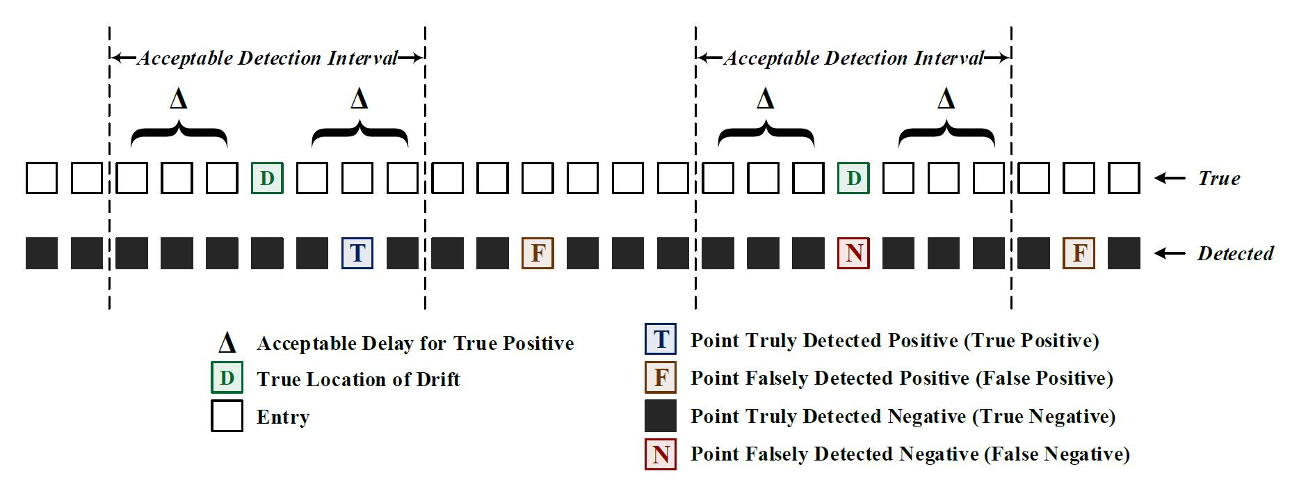
Evaluation Measures

Slide 37

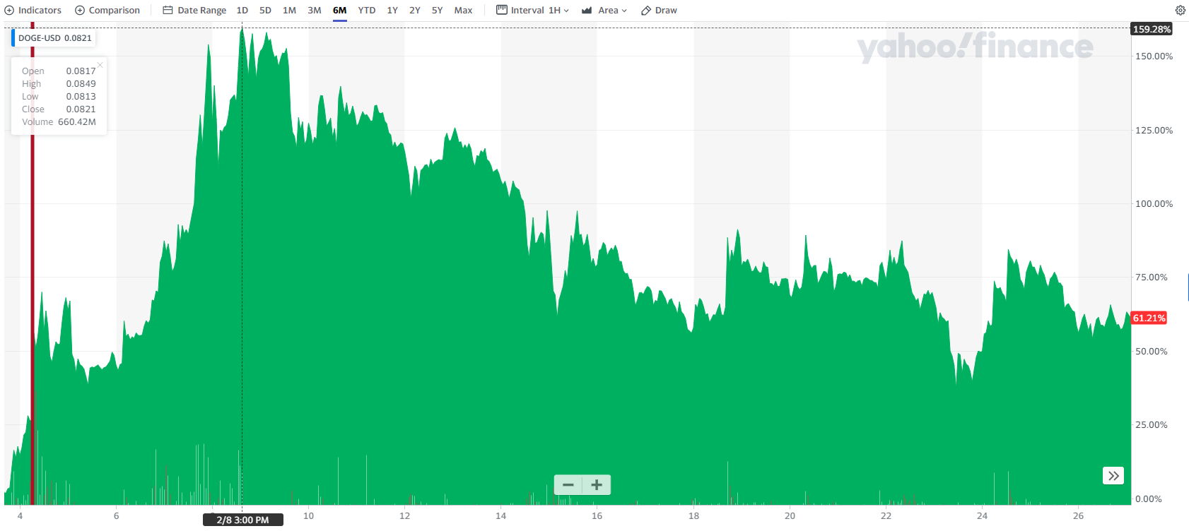
Discussion
Always keep track of your data and your model performance
If your model accuracy dropped (significantly), something is off… most likely due to some shift in data
The significant level varies from my domain to another
If you are not detecting a shift, there could still be a shift in your data
Domain knowledge helps a lot
Different types of data shift can co-occur
Model repository for recurring concepts – Potentially for transfer learning
Some models trained in 2008 could be potentially used in 2020
Track influencers

Slide 38



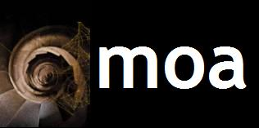
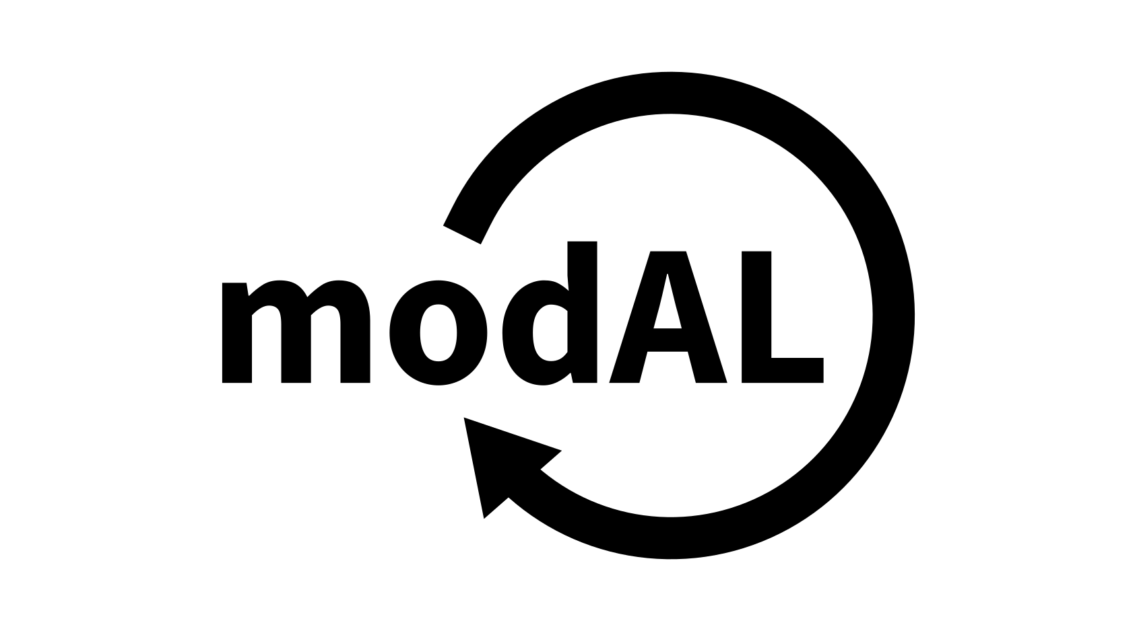
Packages

Slide 39
Q&A

